Slide 1
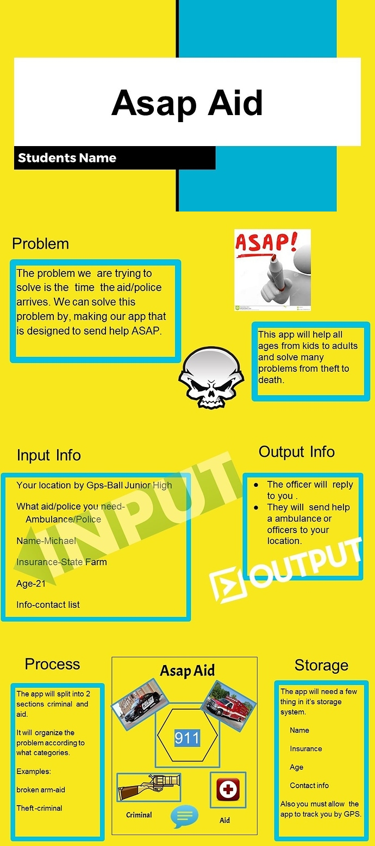
EXAMPLE
VIDEO
CONTENT
“C”
standard
Notes:
You can add your presentation notes here. This presentation template for research posters is fully editable so text, graphics and content can be updated to fit your own research needs.
Download more poster presentation templates from FPPT.com

Slide 2
EXAMPLE
POSTER
CONTENT
“C”
standard
Notes:
You can add your presentation notes here. This presentation template for research posters is fully editable so text, graphics and content can be updated to fit your own research needs.
Download more poster presentation templates from FPPT.com

